Slide 1


Sentiment Analysis
and Recommendation System of Product Reviews
Collaborators: Mike Saunders, Lonnie Aldredge, Giselle Gomez

Slide 2
Agenda
Executive Summary
Data Collection, Cleaning and Transformation
Problem Approach
Model(s) evaluated
Gradio Application
Results and Conclusions
Future Considerations
Resources

Slide 3
Executive Summary
Problem to solve:
Find an easy way to identify products with most positive reviews in order to help with purchasing decision.
Objective:
Build a sentiment analysis system for products reviews using the Amazon Reviews dataset.
The final recommendation tool can be used to identify the most positively reviewed products and make a sales pitch on why you should buy it.

Slide 4
Data Overview
Data Source: https://huggingface.co/datasets/McAuley-Lab/Amazon-Reviews-2023
Chose to work with smaller subsite, Appliances only.
Source format was .jsonl.
Appliance file with reviews
Meta file with product information
Filtered on a random subset of data to use for model training
Flattened data for product categories
Files saved as parquet files to compress and save on file size

Slide 5
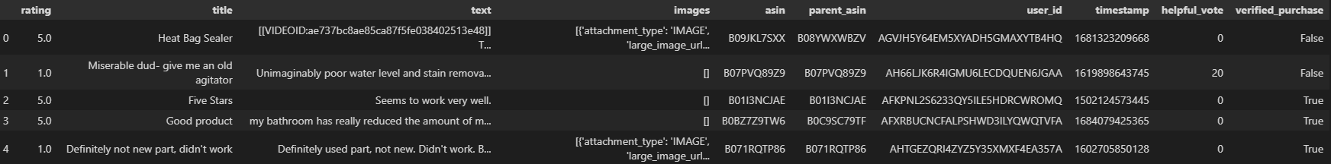
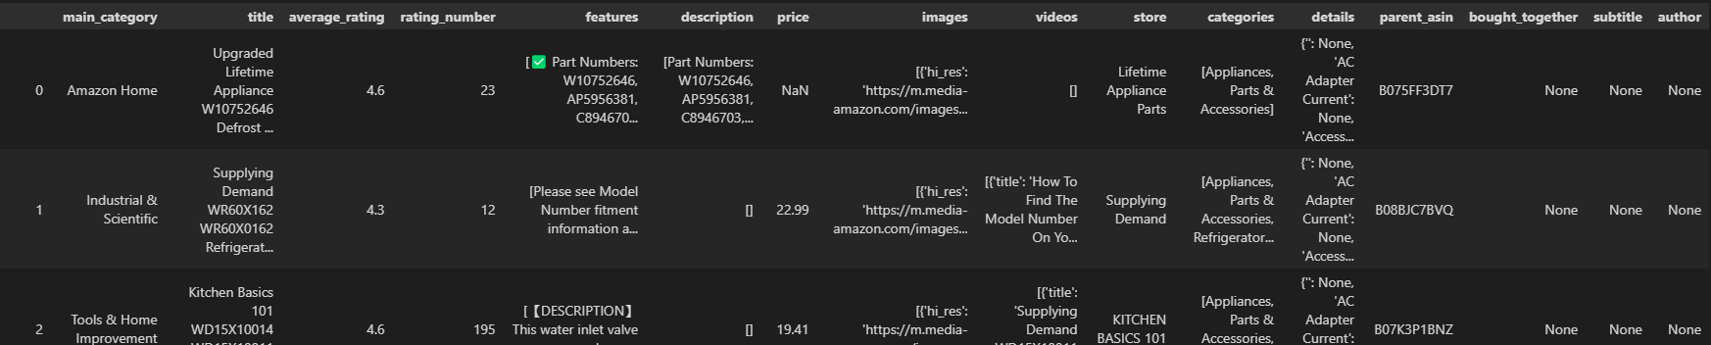
Appliance Reviews
Meta Data

Slide 6
Data Challenge Identified
Cleaning reviews consisted of
Converting to lowercase
Removing special characters and numbers
Tokenizing the reviews
Removing stop words
Problem identified
Removing stop words changed the meaning of many reviews
E.g. “Does not dry well” Changed to “dry well”

Slide 7
Key Libraries Utilized
Pandas: For data manipulation.
Json: For reading source files
Transformers: For loading tokenizer and Roberta model.
Scikit-learn: For data splitting.
TensorFlow: For model training and evaluation.
NLTK: For preparing data for removing stopwords and tokenizing text
OpenAI: For sales pitch generation
vaderSentiment: for sentiment analysis
Gradio: For user interface

Slide 8
Approach to Achieving Project Goals
We explored two sentiment analysis models: VADER (Valence Aware Dictionary and sEntiment Reasoner) and RoBERTa (Robustly Optimized BERT Approach) .

Slide 9
RoBERTa Model
Fit
The model was trained using a training dataset and a validation dataset.
The model was for three epochs using 40,000 training records.
Training accuracy score was 70%
Result
10,000 Validation records were used to determine the accuracy of the model.
Model achieved an accuracy score of 69%
We ran into challenges using this model
Using the model, it was not able to distinguish between reviews
All reviews scored same

Slide 10
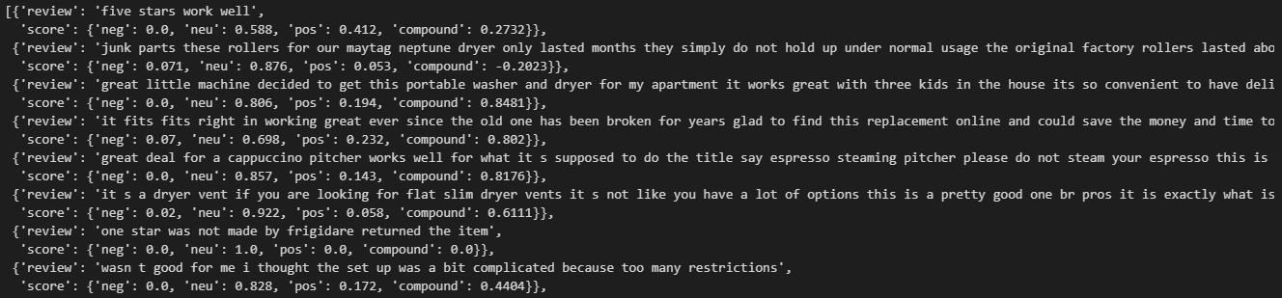
VADER Model
This model worked well to classify each review with a scores
Pretrained model that outputs neg, neu, pos, and compound scores
Scores were used in GUI Application

Slide 11
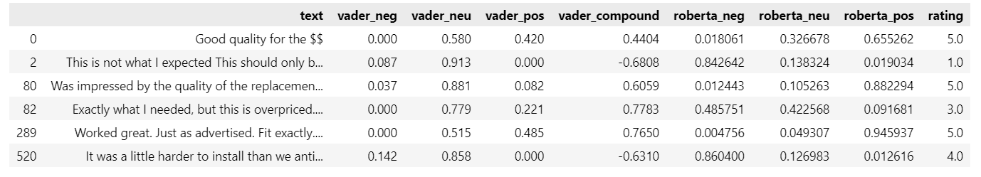
VADER and RoBERTa
With smaller sample of data
VADER proved efficient with straightforward reviews, while RoBERTa provided more nuanced insights, like mixed sentiments or complex wording.

Slide 12
Application Fundamentals
Two Data Files
Appliance reviews
Metadata about specific appliances
Processed, combined, and prepared data for use with our selected model
Function
Looks up all appliance types that match users request
Finds matching reviews for appliances
Finds the average scores from sentiment analysis (must have >100 reviews)
Returns top and bottom products
Gradio used as interface
Allows user to select appliance type
Returns top 3 and bottom 3 reviewed products based on sentiment analysis
Generates a sales pitch based on a random style

Slide 13
Open AI
Chat GPT was used to Generate the Salespitch!
A function to generate the query was created.
Pass in a category, name of good and bad products.
Products used in the prompt were scored by our sentiment model.
Return a prompt for Chat GPT.
Chat GPT “gpt-4o” was issued the query.
The response was a random sales pitch

Slide 14
Chat GPT Prompt
Choose a unique style for a salesperson character, such as Pirate, Shakespearean, Robot, Southern Drawl,
Epic Movie Trailer, Yoda, Salesperson Stereotype, Detective Noir, Sports Announcer, Valley Girl,
Sci-Fi Space Captain, Poetic, Elderly Grandparent, Excited Kid, Formal Business Pitch, or Haunted Ghost.
Select a name for yourself that fits the chosen style. Introduce yourself in character and provide a brief,
engaging product pitch in one or two paragraphs.
Product details:
- **Good Product Name**: Craftsman Blender
- **Bad Product Name**: Acme Blender
- **Product Category**: Kitchen Appliances
- **Good Product Rating**: 4.8/5
Make up good features about the good product.
For the best-reviewed product, explain why it’s the finest choice, focusing on its rating and key feature.
For the worst-reviewed product, tactfully suggest why it may not be ideal. Keep your response to one
paragraph.

Slide 15
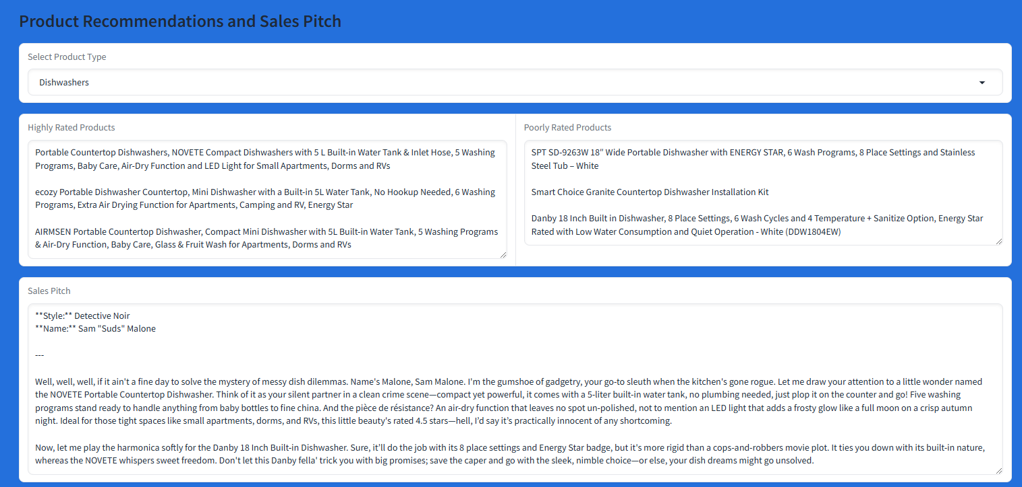
Gradio Interface

Slide 16
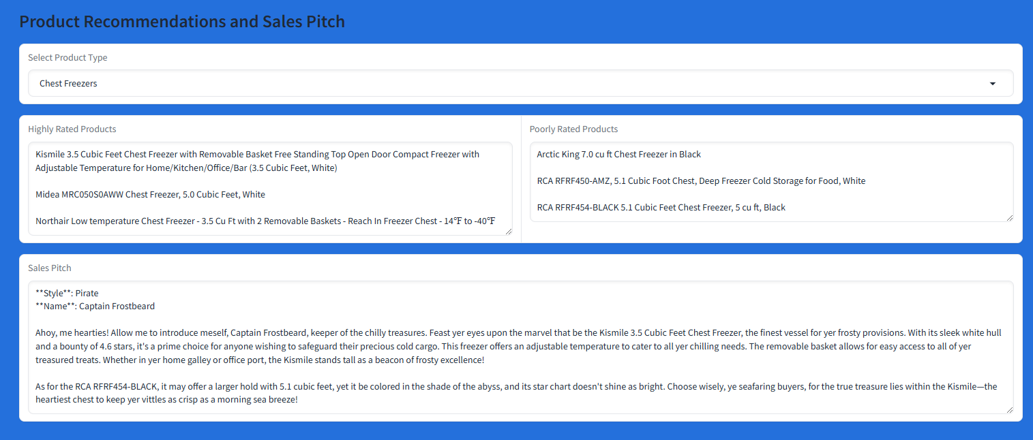
Gradio Interface

Slide 17
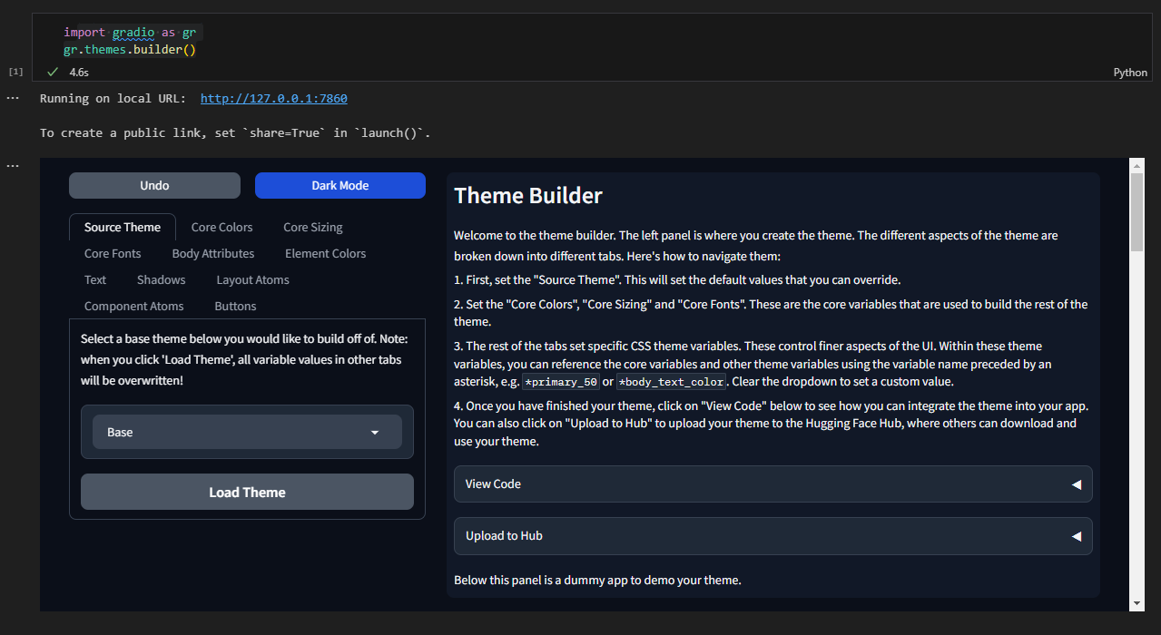
Gradio UI Design
import gradio as gr
gr.themes.builder()

Slide 18
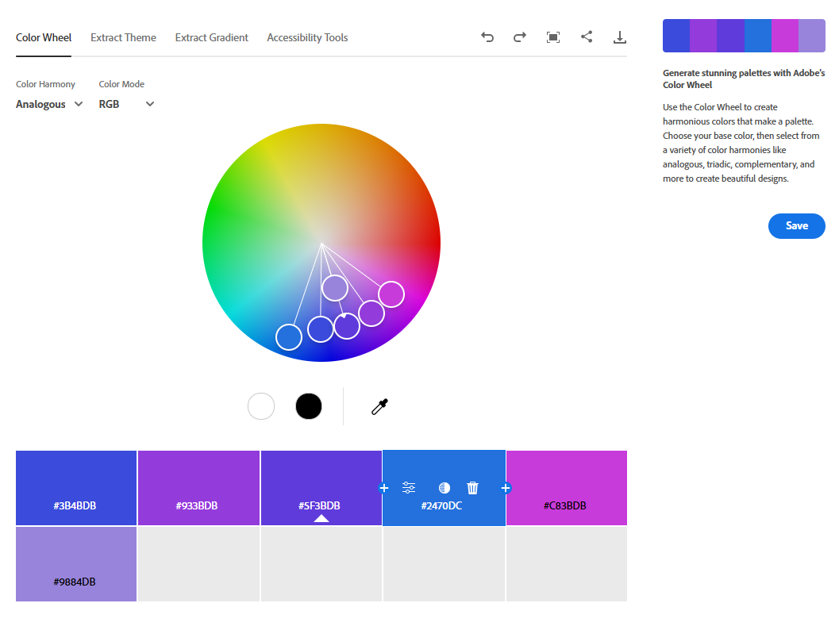
Gradio UI Design
https://color.adobe.com/create/color-wheel

Slide 19

Results and Conclusions
Vader sentiment analysis provided usable and good results
Our application can provide valuable insights into customer reviews and which products are prefered

Slide 20
Recommendations for Next Steps
Expand data set to include more than appliances
Explore additional sentiment analysis models
Identify and remove reviewers who are consistently negative or positive
Improve Sales Pitch Generation

Slide 21

Thank You!
Resources and more info in:
GitHub Repository
Questions?

